Slide 1
DATA100
Principles of Data Science
Exploratory Data Analysis
Notes:
Hi there! Unisse here! In this video, we’ll be talking about exploratory data analysis and the concepts needed for you to get started. (next)

Slide 2
Data Science Project Cycle
Recall
Problem
Start with a question that you want to answer or a problem you want to solve
Data
Maximize the potential of available data from various sources or collect your own
Explore
Understand the information embedded within the data
Learn
Use statistical models, machine learning and other data mining techniques to find patterns faster
Present
Effectively visualize and communicate the insights and knowledge derived from the data
Notes:
In the previous lecture, we talked about the data part of the data science project cycle. (next)

Slide 3

(some) Data Sources
Recall
Collect your own
Survey
Sensors
Field observations
… and more!
Acquire
Open data websites
Website API
Data request (e.g. FOI)
Web scraping (make sure this is ethical and legal!)
… and more!
Notes:
More specifically, we focused on collecting our own data through an API and web scraping.
If you have any questions still about collecting data from the web, please let me know. There are many ways you can program your data collection scripts so you can get creative and resourceful!

Slide 4
Data Science Project Cycle
Recall
Problem
Start with a question that you want to answer or a problem you want to solve
Data
Maximize the potential of available data from various sources or collect your own
Explore
Understand the information embedded within the data
Learn
Use statistical models, machine learning and other data mining techniques to find patterns faster
Present
Effectively visualize and communicate the insights and knowledge derived from the data
Notes:
Now that we have some data, let’s work towards exploring and finding out what we were able to collect. (next)

Slide 5
Exploratory Data Analysis
Descriptive Analysis
Summarizing the data without any interpretation
Data Cleaning
Finding the data errors and handling each type of error accordingly
Preliminary Visuals
Using simple charts to locate data errors and understand the data that is available
Notes:
Exploratory data analysis is a broad subfield in data science wherein we do descriptive analysis, data cleaning and create some preliminary visuals to guide us in our exploration. (next)

Slide 6
Descriptive Analytics
How many variables and observations are in the data?
What is the most common value for each variable?
How many categories are there?
How different are the observations from one another?
Descriptive Statistics
Notes:
For the descriptive analysis, the common questions we ask ourselves when we get our hands on data are:
(read slides)
There’s a lot more questions you can ask but basically, it all boils down to using descriptive statistics to understand or summarize your data better. Using summarized statistics can give you a general view of the data first and then you can zoom in on the details after.

Slide 7
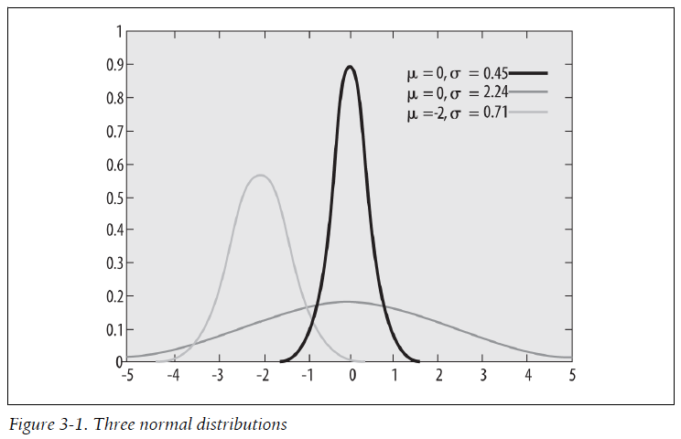
Probability Distributions
“A theoretical probability distribution is defined by a formula that specifies what values can be taken by data points within the distribution and how common each value will be (or, in the case of continuous distributions, how common a given range of values will be).”
Boslaugh, S. (2012). Statistics in a nutshell: A desktop quick reference. " O'Reilly Media, Inc.".
Notes:
To quickly recap what statistics have to do with data science, we need to remember what probability distributions are. (or simply distributions).
(read definition)
In data science, having an understanding of statistics can help you greatly since you can deduce how random or how normal the data you have is. We also use a lot of models that are based on distributions, so there is a need to understand what they are.

Slide 8
Measures of Central Tendency
Location of the data
Gives an idea of what the most common observation value looks like
Types of Measures .
Mean
Median
Mode
Notes:
For data and distributions, there are certain measures (or statistics) that we commonly use in data analysis.
The first are the measures of central tendency. These measures give the location of the data in the distribution and gives us an idea of what the most common observation looks like. These measures are your mean, median and mode.

Slide 9
Measures of Central Tendency
Mean
Average
Interval and ratio data
Good to use when data is normally distributed (no extreme values)
Median
Middle value when data is ordered
50th percentile
Quantitative data
Better for skewed data (with extreme values)
Mode
Most frequently occurring value
Categorical data
Notes:
The mean is your arithmetic average wherein you simply take the sum of all values and divide it by the total number of values. This is normally a good metric for comparison and reporting when your data is normally distributed.
The median is the middle value of your distribution -- it’s the middle value when the data is ordered. Also known as the 50th percentile. The median is a better reference of the most common value if your distribution is skewed or imbalanced. Both the mean and the median are used for quantitative data.
For categorical data, the measure for central tendency is called the mode. It basically gives you the most frequently occuring value in the dataset.

Slide 10
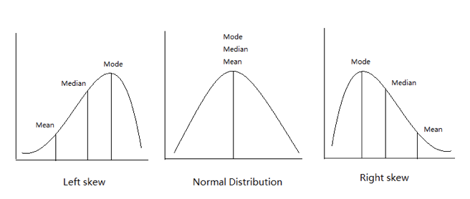
Comparing the Measures
Notes:
In terms of comparing the mean, median and mode in a distribution. You can see that for a normal distribution, all the measures are the same. However for a left and right skew distributions, there is a difference in the order.

Slide 11
Measures of Dispersion
How spread out are the values in the data
Types of Measures .
Range
Variance
Notes:
Another statistic that is important to know when doing exploratory analysis is the measure of dispersion or how spread out are the values in the data. The common measures here are the range and the variance.

Slide 12
Measures of Dispersion
Range
Simplest measure
Difference between the largest and smallest values
An unusually wide range (extreme minimum and maximum values) requires further investigation.
Variance
Average squared differences from the mean
Standard deviation
How different is it from the mean?
Notes:
Range is a fairly simple measure, you just have to take the difference of the largest and smallest value. If you have an unusually large range, then you may want to take a look at the distribution as a whole since there might be outliers or weird numbers in your data.
The variance is the average squared differences of each value from the mean. The more commonly used value though is the standard deviation, which is the derived from the variance. It basically answers the question, how difference is this value from the mean?

Slide 13
Why do we need to understand the distributions of data?
Most statistical tests and analytical methods are based on the assumption that data follows a certain type of distribution.
Notes:
So, why do we need to understand the distributions of the data? From an analytical perspective, most models and statistical tests base their computations and formulas on a certain type of distribution. Take for example the z-test, it assumes that your data has to be normally distributed before you can do the test!
Additionally, in terms of data cleaning and processing, seeing the distribution of your data and knowing the descriptive stats can help you find any anomalies or errors in the data.

Slide 14

Data errors are common.
Data collected from various sources are far from perfect.
Notes:
Data errors are more common than you may think! Using exploratory data analysis to uncover these problems is crucial to your next steps. Since data are collected from various sources, we need to make sure they match before merging data sources or there may be misspellings or other input issues.

Slide 15

Data cleaning takes up ~50% of the time.
Since data is not perfect and data science is all about using data from various sources, cleaning and processing data for analysis takes up a lot of time.
Notes:
To be fairly honest, data cleaning and processing takes the most amount of time in the entire data science project cycle! Most data scientists estimate that they spend approximately 50% of their time cleaning data (or more!!!)

Slide 16

Common Data Problems
Input errors
Missing values
Duplicate records
Formatting issues mm/dd/yyyy vs yyyy/mm/dd
Varying representation January vs Jan vs 1 vs 01
… and many more!!!
Notes:
Why do we spend so much time cleaning data? Well, the common data problems or culprits are input errors, missing values, duplicate records. Sometimes, the issue lies with differences in formatting and representation. The most common problem are with dates! Here in the Philippines, we follow the MMDDYYYY format but in other countries, they follow the year month day format for better sorting.
There’s a lot more data issues out there but these are the common ones that you have to always look out for when you’re cleaning data.

Slide 17
Is there a catch-all way to clean data?
Straightforward answer, NO.
But there can be guiding principles.
Notes:
But wait, you may ask, Is there a catch-all way to clean data? To make our lives as data scientists easier?
To be honest, there’s no one single way to clean your data. But there can be guiding principles or checklists to help us. Think of it like a laundry list of things to clean!

Slide 18
Data cleaning is a science and an art!
There are common steps and repeatable steps you can take to clean data but it is highly dependent on the data and the analysis to be done!
Notes:
Data cleaning is more of a process of science and art combined. The same dataset may be cleaned in different ways depending on the analysis the analysts plan to do. Like for example, do you drop all rows with missing values? Or do you fill it in with some value? If you do fill it in, what value will you use? Why that? There’s really a lot to consider.

Slide 19
The model is only as good as the data.
Notes:
But it all boils down to what analysis you’re doing and what model you plan to build with the data. You have to always remember that the model that you build is only going to be as good as the quality of the data. So if your data has garbage values or erroneous values, then your model will make mistakes.

Slide 20

Use visuals or charts.
Exploratory visuals aid in locating errors and highlighting unusual patterns in the data.
Notes:
Lastly, make sure to also use visualizations to help you see your data better while you explore. We’ll cover more about visualization in the next modules but simple histograms and frequency bar charts or even scatterplots can help you find anomalies in your data.

Slide 21
Questions?
Notes:
That’s it for the concept part of exploratory data analysis. In the next video, we’ll show you how to clean data using python and pandas. If you have any questions about the topic, please don’t hesitate to ask over on our discord server! :) Let’s have a conversation there to better interact with one another. Thanks and see you in the next video!

